Slide 1
Transformer-XL

Slide 2
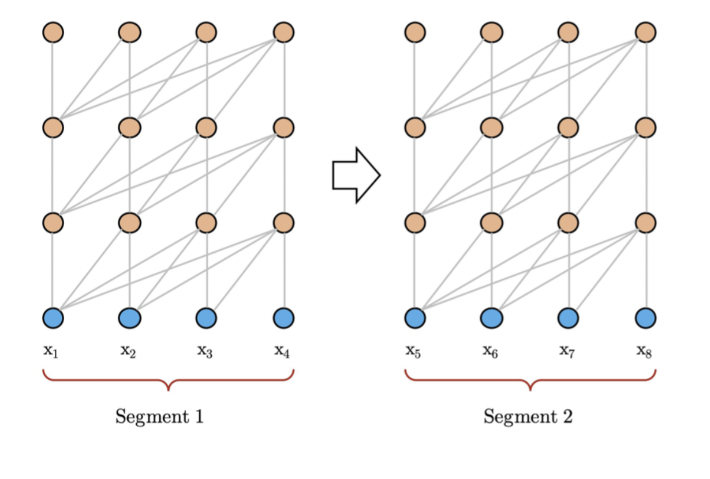
Недостатки vanilla transformer
Текст должен быть предварительно разделен на несколько сегментов
Notes:
Processes sequences parallelly and can only process a fixed-length segment at a time. This is because, if we use the whole sequence, then we have to operate on very large matrices. This requires a large amount of memory. So, we divide the given sequence into fixed-length segments and process each one of them separately. But, this leads to a limited context (maximum context length=chosen segment length) as the current segment can’t interact with the previous segment. This makes predicting the first few words (for each segment) difficult, as they have no context. This problem is called context fragmentation.

Slide 3
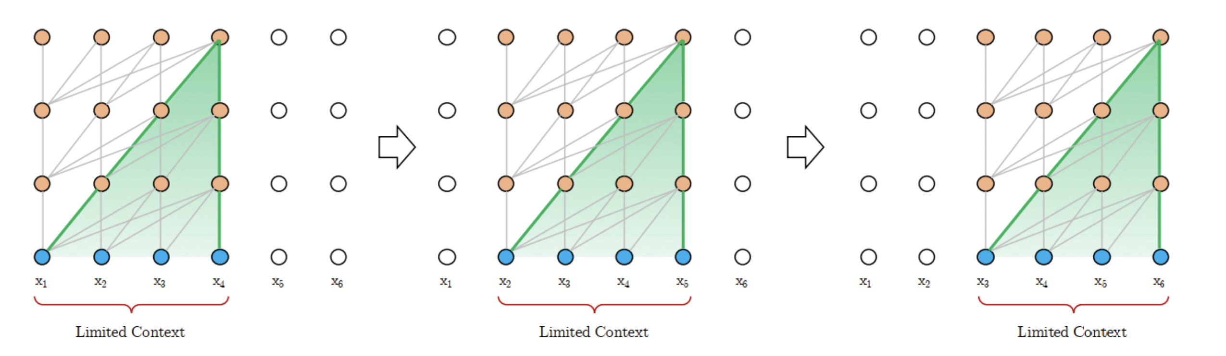
Недостатки vanilla transformer
Дорогая и медленная evaluation
Notes:
During the evaluation, at each step, the transformer takes the same segment length as used during training, but predicts the word for only the last position (of each segment). At the next step, the segment is shifted by one position to the right and the new segment is processed from scratch. This uses the maximum context length used during training and also relieves the model from the context fragmentation issue. But, this process is slow and expensive.

Slide 4
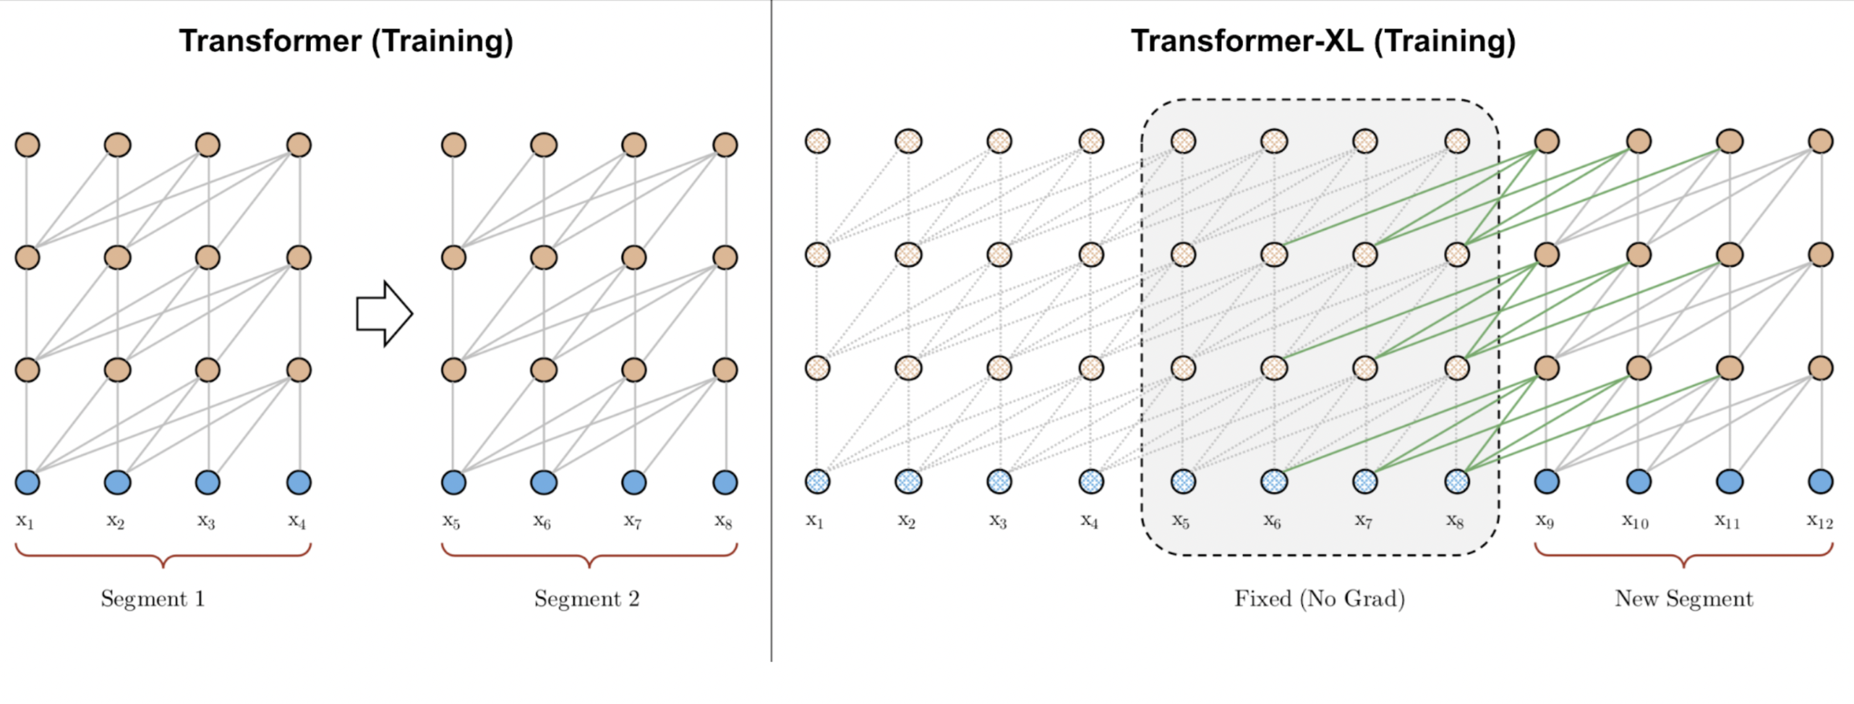
Hidden State Reuse

Slide 5
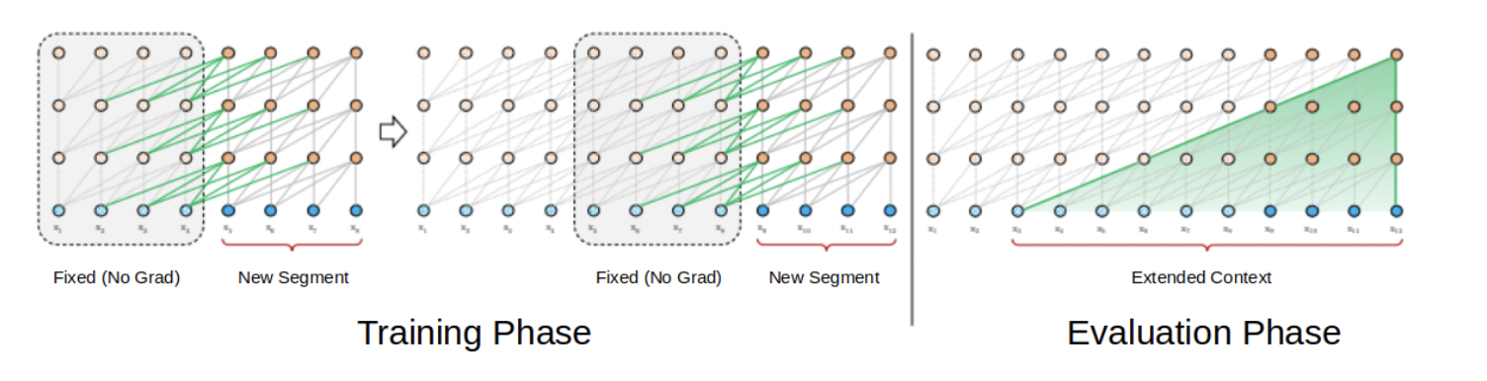
Hidden State Reuse
Notes:
During the evaluation phase, the representations from the previous segments can be reused instead of being computed from scratch (as is the case of the Transformer model). This, of course, increases the computation speed manifold.

Slide 6
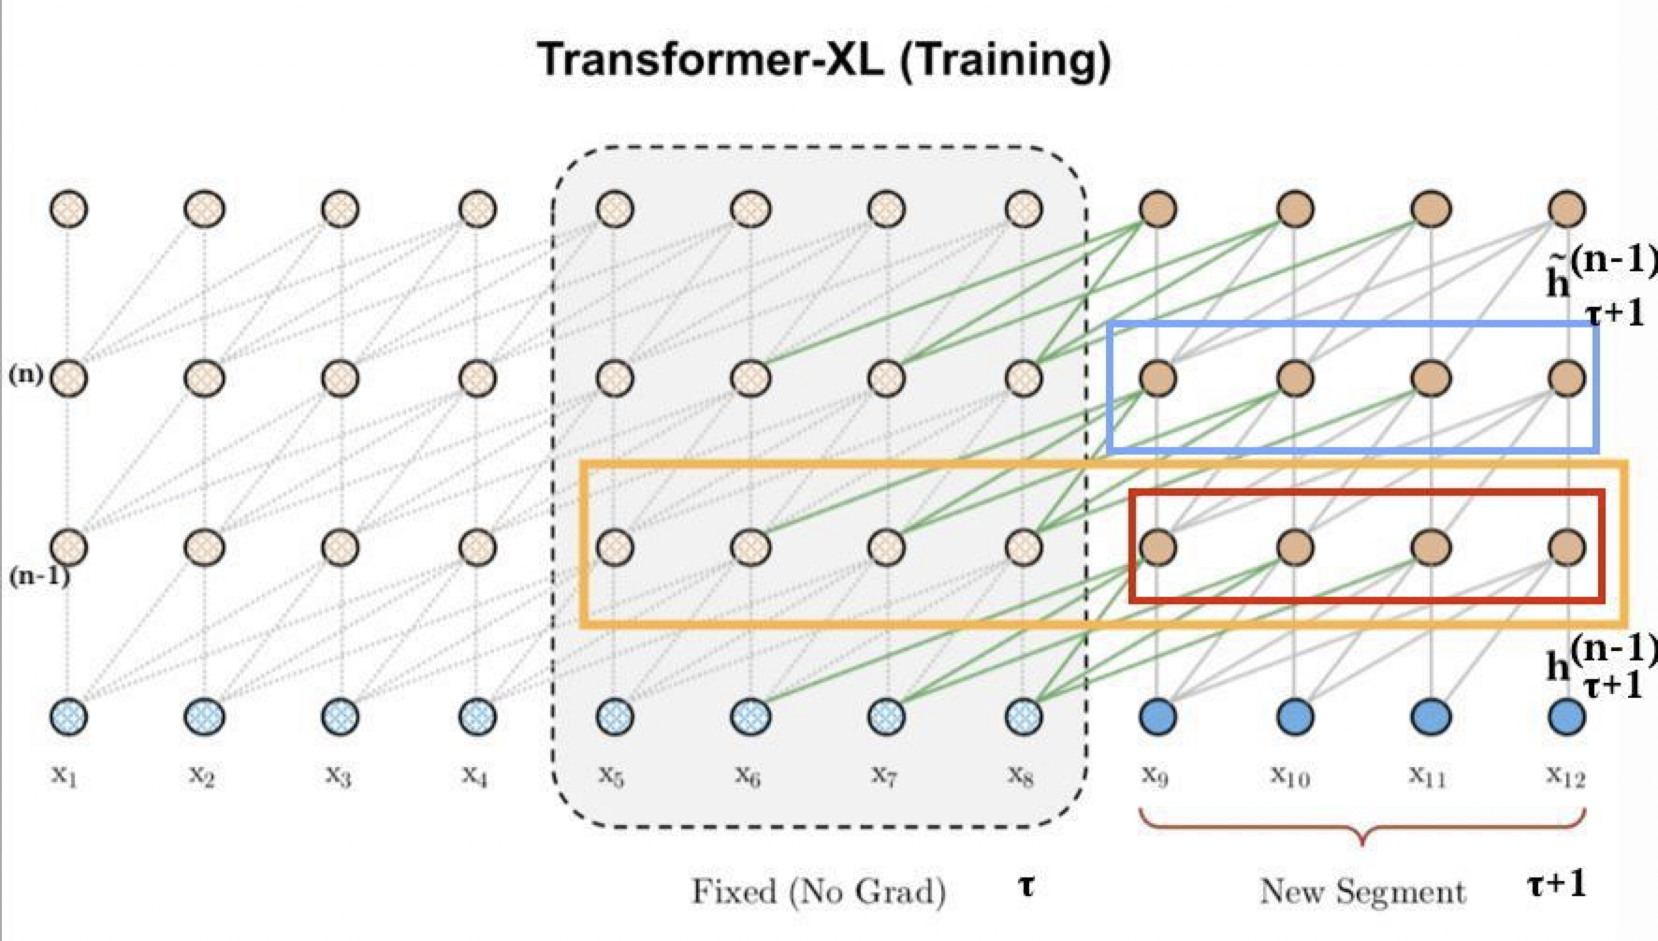
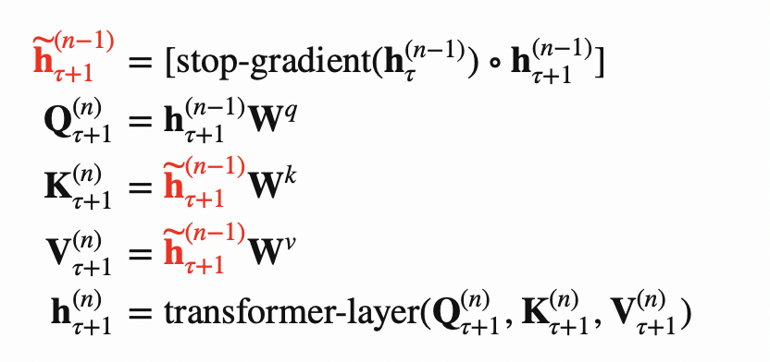

Slide 7
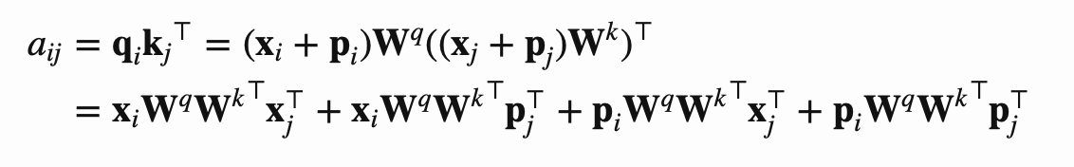
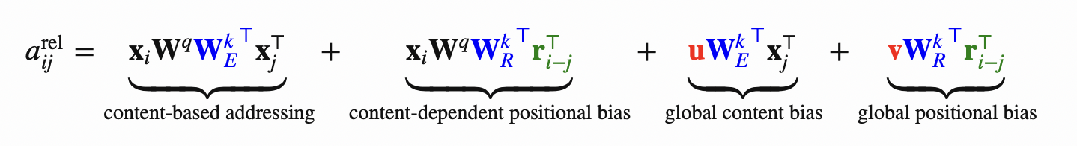
Relative Positional Encoding
Было:
Стало:
Notes:
The original positional encoding handles each segment separately and, as a result, tokens from different segments have the same positional encoding. For example, the first token of the first and the second segments will have the same encoding, although their position and importance are different (the one from the first segment is probably lower). This confusion might affect the network incorrectly.

Slide 8
Relative Positional Encoding
p_{j} заменена на relative positional encoding r_{i-j}
p_{i}W^{q}
заменена на два обучаемых вектора u (для содержания токена) и v (позиции токена)
W^{k} разделена на W_{E} ^{k} (для обучения информации о содержании токена) и W_{R}^{k}
(для обучения информации о позиции токена)

Slide 9
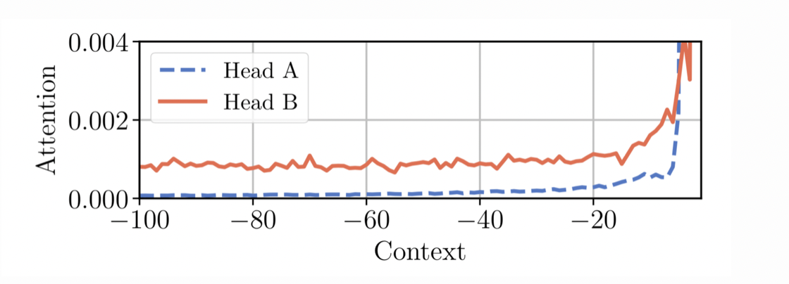
Adaptive Attention Span
Разным головам attention может быть нужен attention span разной длины, поэтому можно для каждой головы
подбирать длину отдельно.
Notes:
пусть каждая голова (self-attention head) сама будет обучаться тому, насколько далеко в прошлое ей смотреть. То есть этот S, длина контекста, будет не гиперпараметром, а обучаемым параметром.

Slide 10
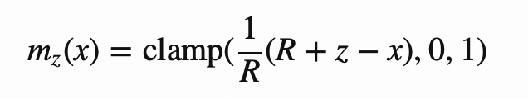
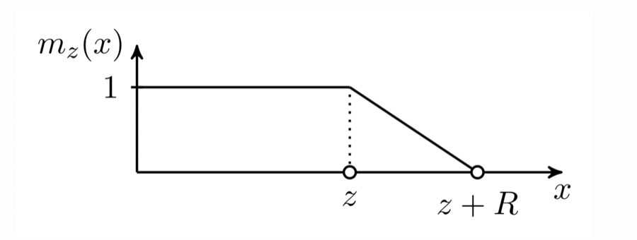
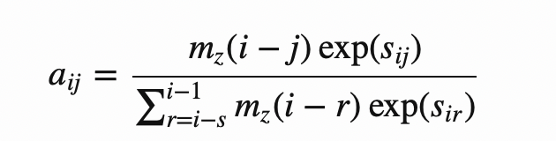
Adaptive Attention Span
soft mask function:
Notes:
пусть каждая голова (self-attention head) сама будет обучаться тому, насколько далеко в прошлое ей смотреть. То есть этот S, длина контекста, будет не гиперпараметром, а обучаемым параметром.

